Slide 1
Biomass
Siranush Asatryan

Slide 2
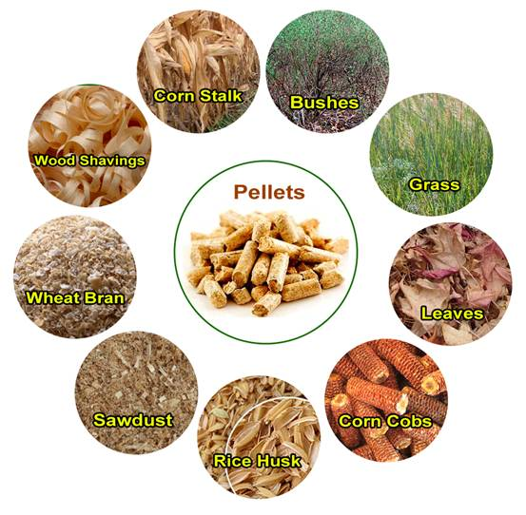
What is biomass?
Biomass is all plant and animal matter on the Earth's surface. Biomass is anything that is alive. It is also anything that was alive a short time ago.

Slide 3
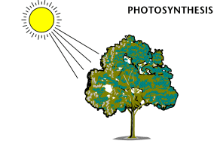
Where does biomass get its energy
Biomass gets its energy from the sun. Plants store the sun’s energy in their leaves and roots. Then animals eat plants and other animals to move and grow. The energy of the sun is 'captured' through the process of photosynthesis in growing plants. Biomass energy is renewable, which means we can make more biomass in a short time. We can always grow more plants.

Slide 4
What can we do with biomass?
Biomass can be used to make electricity. Many towns burn their garbage in waste-to-energy plants. Instead of putting the garbage in landfills, they burn it to make electricity. Biomass can be used to make an energy-rich gas called biogas. Biogas is like the natural gas we use in our stoves and furnaces. Biomass can also be turned into a fuel like gasoline. Just as apples can be made into cider, corn and wheat can be made into ethanol. Ethanol is a fuel a lot like gasoline.

Slide 5
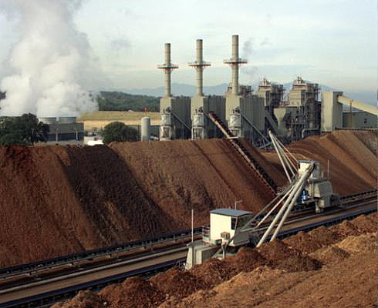
Photo of wood fired biomass plant in California

Slide 6
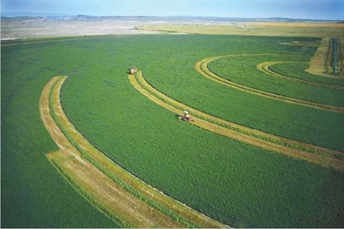
Growing biomass in USA

Slide 7
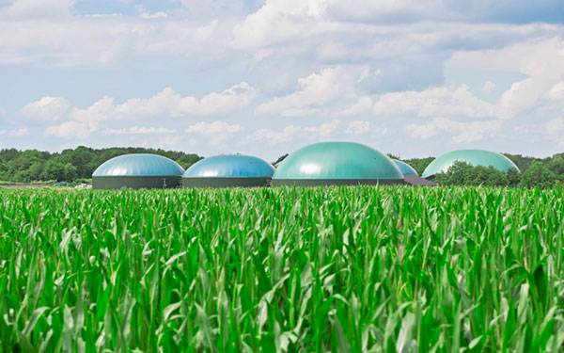
5 reasons to use biomass
Does not cause air pollution or global warming.
Biomass products are abundant and renewable.
33% saving on oil prices.
100% natural gases, clean energy.
Landfills and garbage can be used as biomass energy.
Why people don’t use biomass?
Requires more lands.
It is expensive.

